Slide 1
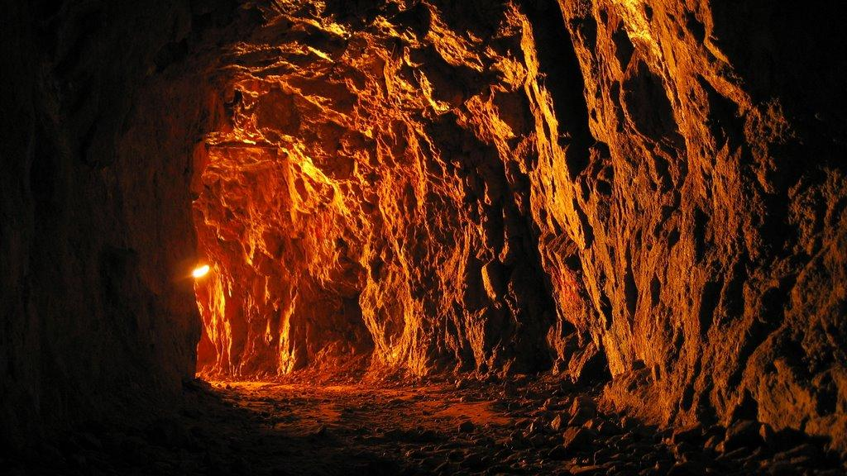
Mining Conditions
Mining Revolution

Slide 2
Conditions underground
1906 - Robinson Deep Mine in JHB was the deepest mine in the world (800 m deep)
Dangerous conditions
The deeper inside, the hotter it gets
pump water & hot air out
worked with dynamite
pockets of gas (exploded!)
No protective clothes
Rock falls

Slide 3
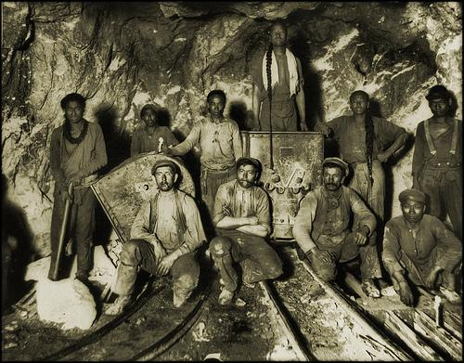
Conditions Underground
Dust from the drilling was also a hazard
inhaling the dust led to silicosis
inhaling wet air caused pneumonia
tuberculosis also spread

Slide 4
Inside a deep-level mine
Two shifts a day (day and night)
Started at 04h00 or at 15h00
Between 9 & 15 hours long
Black miners did not return to the surface during this time
If they took breaks they had to take their own food
White supervisors could take breaks, earned more and were better housed

Slide 5
Randlords and the formation of the Chamber Mines
1889 - rising costs of mining left 44 mining companies bankrupt
decided to join together and form large mining houses
They were European capitalists - the Randlords
They formed an organisation called the Witwatersrand Chamber of Mines
Main aim - to keep mining profitable
decided on low wages to keep profits high
new laws and taxes to recruit more workers

Slide 6
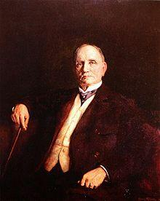
Joseph Benjamin Robinson
One of the richest Randlords. He bought up large amounts of land on the Rand in 1886.

