Slide 1
Southern Africa
by 1860
History - Grade 8

Slide 2
What South Africa looked like?
Britain had a large influence on SA
Natal was a British Colony
Indian labour was brought to SA by the British
Indians also chose to come to Natal to start businesses
By 1860 the Boers & the British expanded

Slide 3
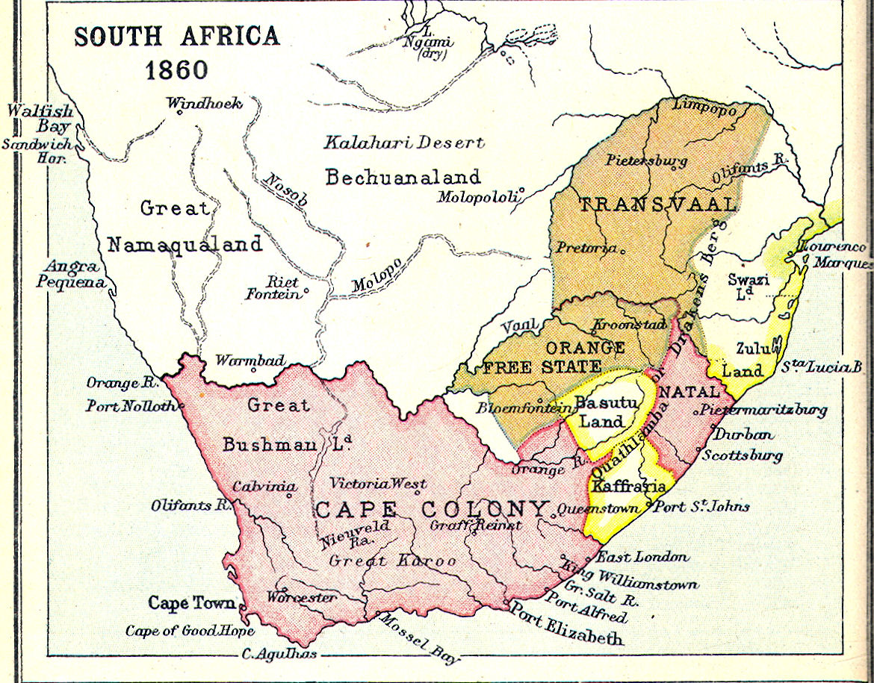

Slide 4
Indentured labour from India
Indentured labour: a labour system where a worker works for a “master” or boss under a signed agreement.
First group of Indian labour - indentured
worked on sugar plantations in Natal
exported to Britain where it was refined
After 10 years: free or could go back to India
could claim land in SA
many chose to stay in SA

Slide 5
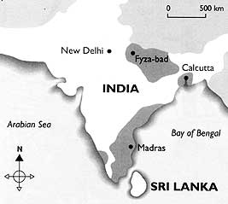
Where did they come from?

Slide 6
India as a British Colony
India and Britain - trading since 1612
British East Indian Company - Surat
Indian Rebellion of 1857
Britain start taking over land
1853 - British Colony
“jewel in the crown”
Gold, gemstones, cotton, tea
Income from taxes

Slide 7
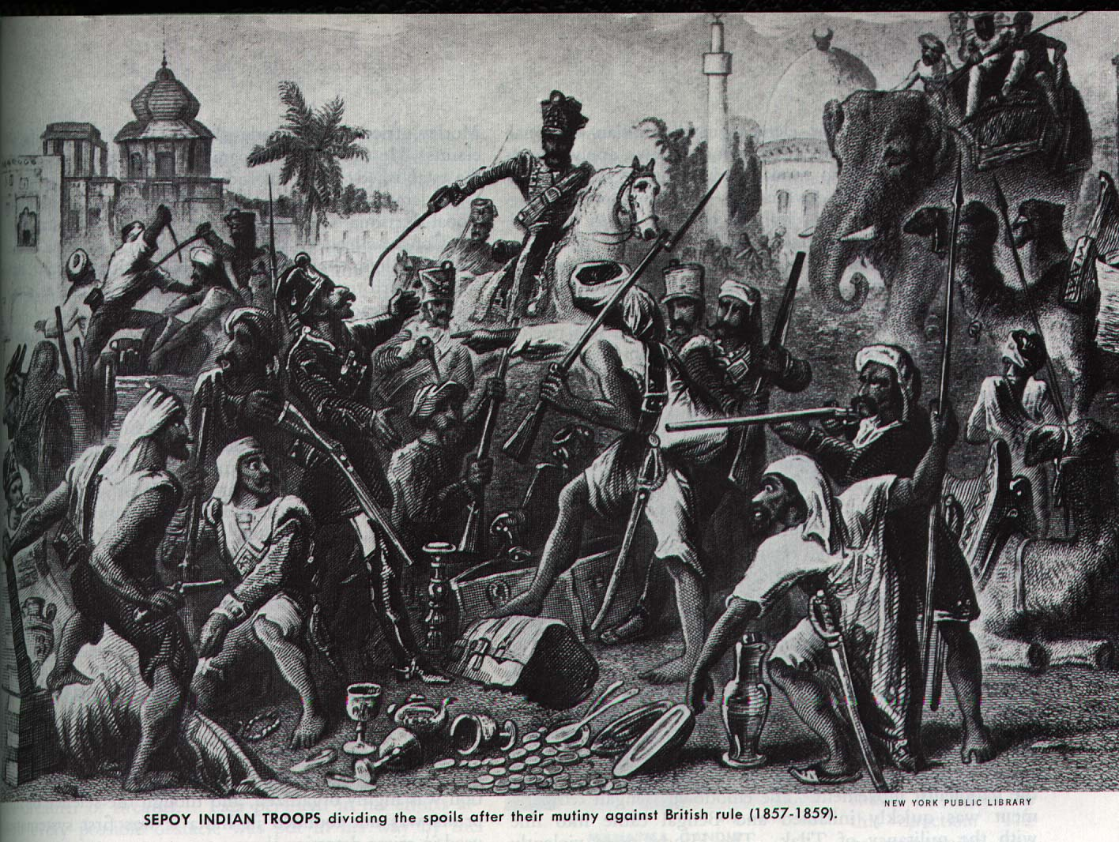

Slide 8
Why Indian Labour?
Natal was excellent for growing sugar cane
No labour force in Natal
Zulu unwilling to work (still independent)
1870’s slavery abolished
India was a solution
22 November 1860 - started arriving
Between 1860 - 1911 Natal paid for 150 000 Indians to be brought to Natal

Slide 9
Why sugar?
A source of income (tax) for Britain to run the colony
new buildings
officials
army
Refined in Britain
used in many products
sweets industry was booming
Cadbury - Birmingham

Slide 10
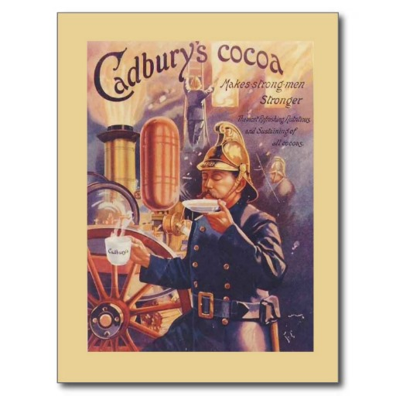
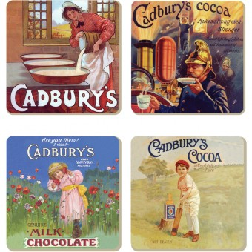
Cadbury

